Slide 1
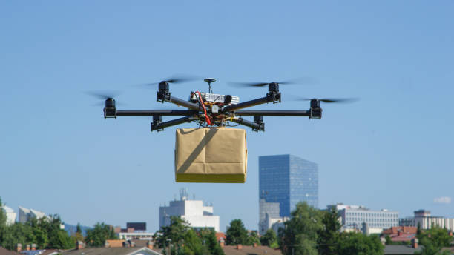
Drone delivery systems using graph theory
Pradeep Yendluri
Siva Rama Krishna Kakarla
Varuna Sri Budidi
Sai Teja Nagulla
Anooshma Vainala
Graph Theory 5170.002 – Group 8

Slide 2
AGENDA
Introduction
Problem Statement
Using Graph Theory
Algorithm Selection
Approach
Implementation
Demo

Slide 3
INTRODUCTION
In the ever-evolving world of drone delivery systems, the implementation of efficient routes plays a pivotal role in optimizing delivery operations.
Drones Applications include last mile delivery, search and rescue, surveying, disaster response, and agriculture.
Drones have plethora of use cases in everyday life.

Slide 4
PROBLEM STATEMENT
Last mile delivery systems include the most complexity of logistics system.
Finding optimal routes for package delivery becomes hard due to the limitations of current drone technology.
We are focusing on finding optimal route from warehouse to end customers.
This includes delivering multiple packages in single go. This can be achieved using a vast network of charging points.

Slide 5
Using graph theory
Graph theory plays a crucial role in optimizing and enhancing drone delivery systems in everyday life.
Graph theory algorithms assist in identifying the shortest or fastest paths between pickup and delivery locations, minimizing travel distances
By leveraging algorithms like Dijkstra's algorithm, A* search, or the traveling salesman problem (TSP) algorithm, companies can determine the most efficient routes for drones to navigate.

Slide 6
ALGORITHM SELECTION
We chose Open Traveling Salesman Problem an extension of TSP to relate to our current problem - drone delivery system and solve it using dynamic programming.
The Traveling Salesman Problem (TSP) is a widely studied optimization problem that is known for its NP-hard complexity. It involves finding the shortest possible route that visits a set of cities and returns to the starting city, considering the distances between each pair of cities. Essentially, the goal is to identify the shortest Hamiltonian cycle in a complete graph.
We can solve OTSP using algorithms like Greedy algorithm, Dynamic Programming, branch and bound method and Genetic algorithm.

Slide 7
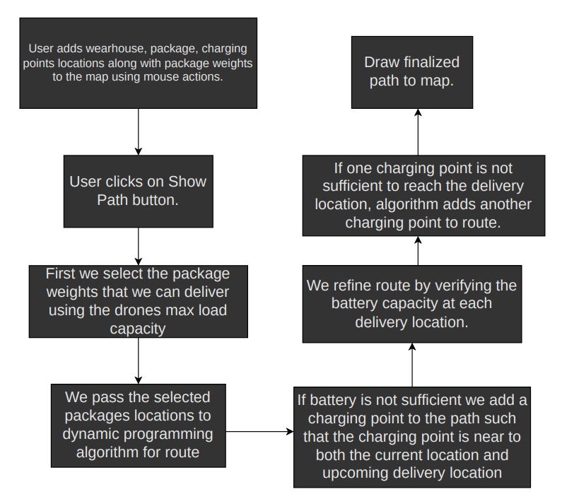
Approach
User can add warehouses, packages, charging points to the map before proceeding with the route planning.
Code first selects packages based on weights and then send those locations for further processing.
TSP-dynamic algorithm implementation will provide shortest route found.
Route is then populated with charging points if power is not sufficient during the travel.
Finalized map is then drawn onto map

Slide 8
implementation
We used python language to implement the solution.
Used TSP dynamic algorithm package for finding route between selected packages and warehouse. (https://github.com/fillipe-gsm/python-tsp)
Used customtkinter, TkinterMapView library for UI implementation. (https://github.com/TomSchimansky/CustomTkinter)
(https://github.com/TomSchimansky/TkinterMapView)
To calculate distances between locations, we used geopy python package.(https://github.com/geopy/geopy)

Slide 9
THANK YOU

